Slide 1
a web
szépség
e
Tóth András Mihály

Slide 2
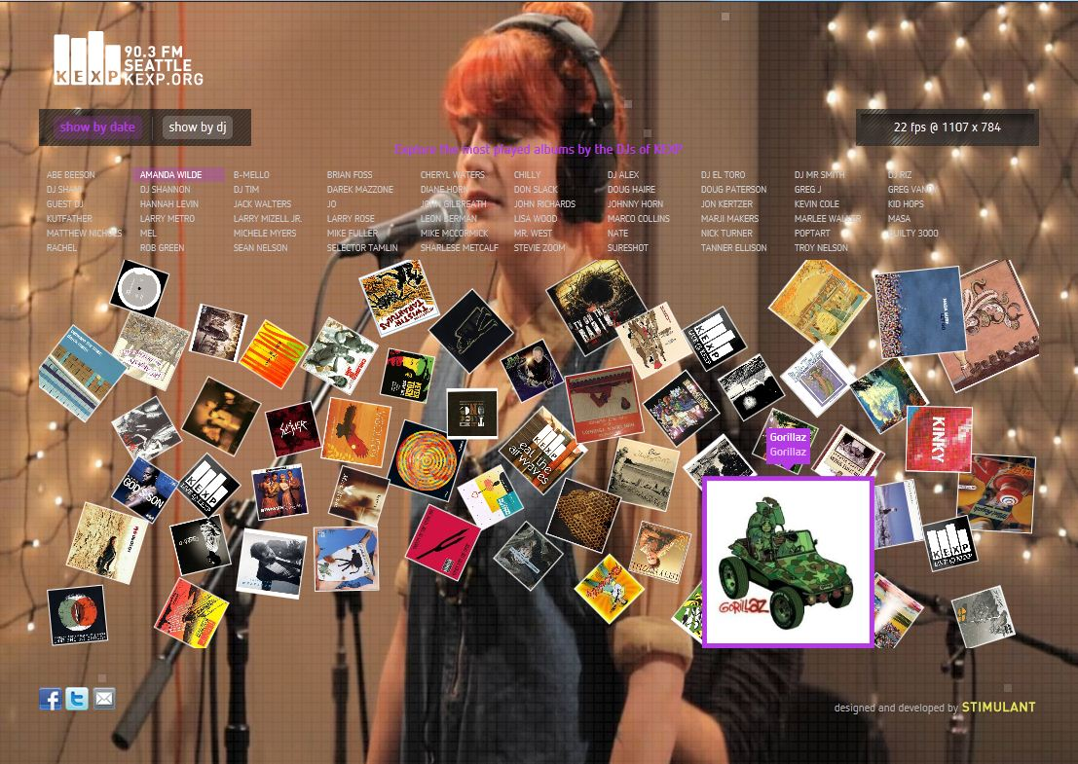
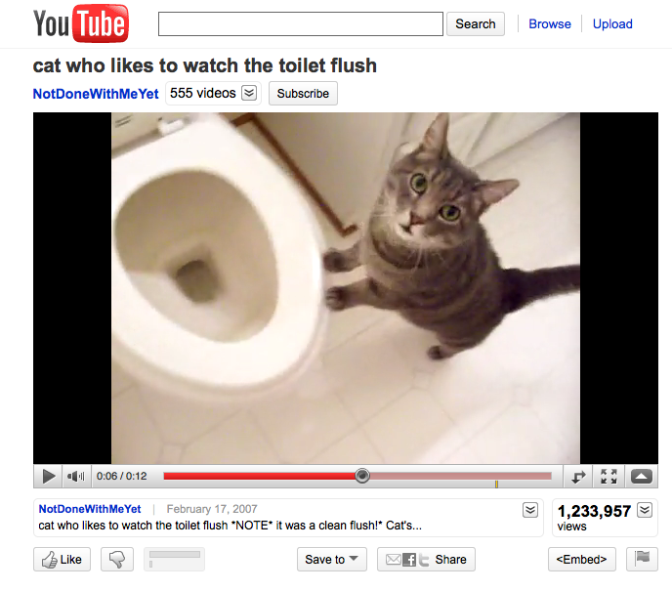
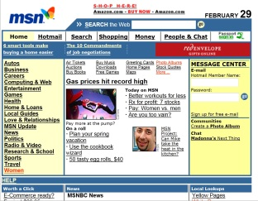
nőnek az elvárások a webbel szemben
Notes:
Now, let’s dive into the evolution of the web and how it had dramatically changed over recent years.
The web yesterday was static, content focused – a utilitarian tool. People spent their time finding and consuming data, but it was difficult to share information in real time.
The web today is increasingly interactive, personalized and an increasingly social place to share and watch videos.
As we look to tomorrow’s web, we see an interactive web with rich graphics and fast performance. We see an increasing number of rich web applications connecting and engaging users. And as the promise of these rich web application dominates the user experience and as users spend more time in the browser on their PC – they will come to expect more, they will expect the same richness and interactive capabilities once exclusive to native PC applications.
The reality is today’s browsers however are wholly insufficient for this upcoming web.
As the web comes to dominate the time customers spend on their PC, they will expect more - they will come to expect the same capabilities as the applications on their Windows PC

Slide 3
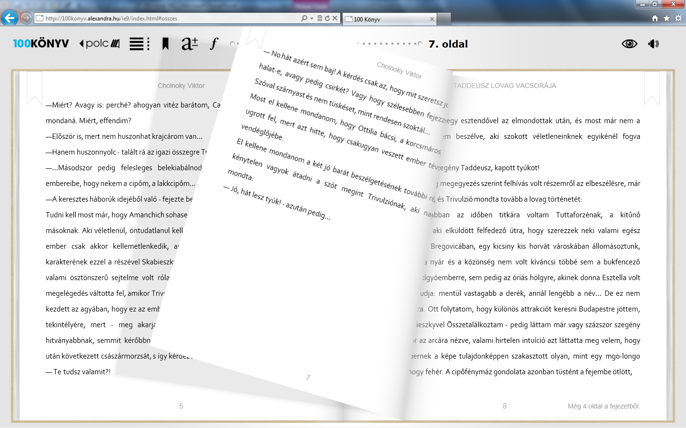
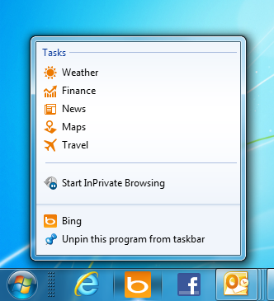
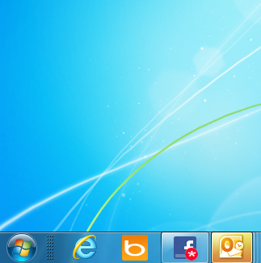
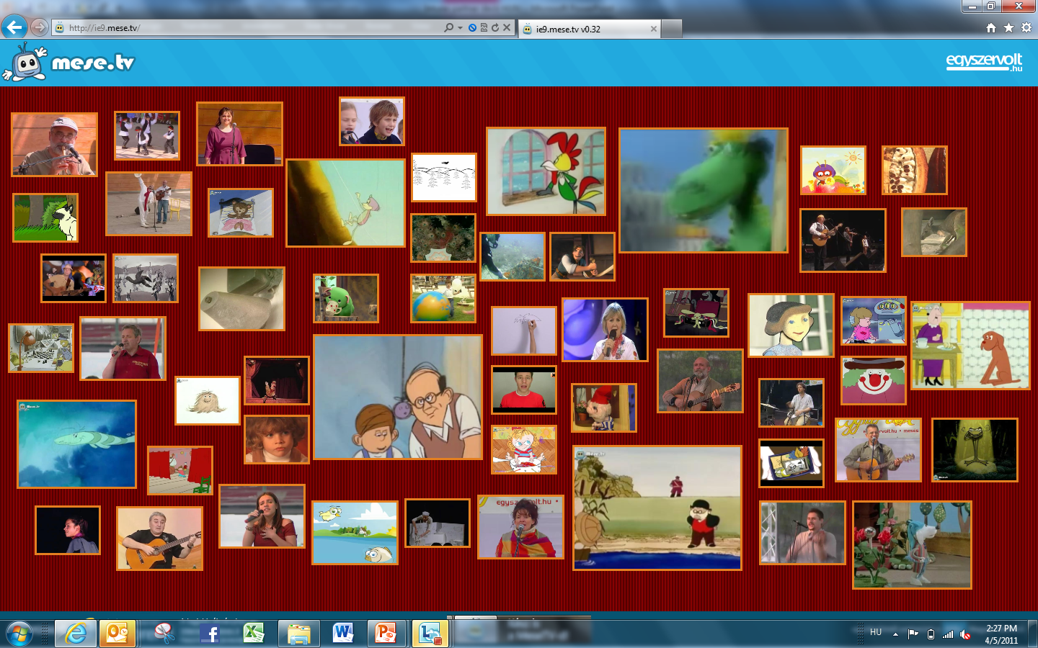
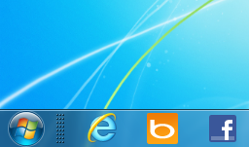
Windows 7 integráció és html5

Slide 4

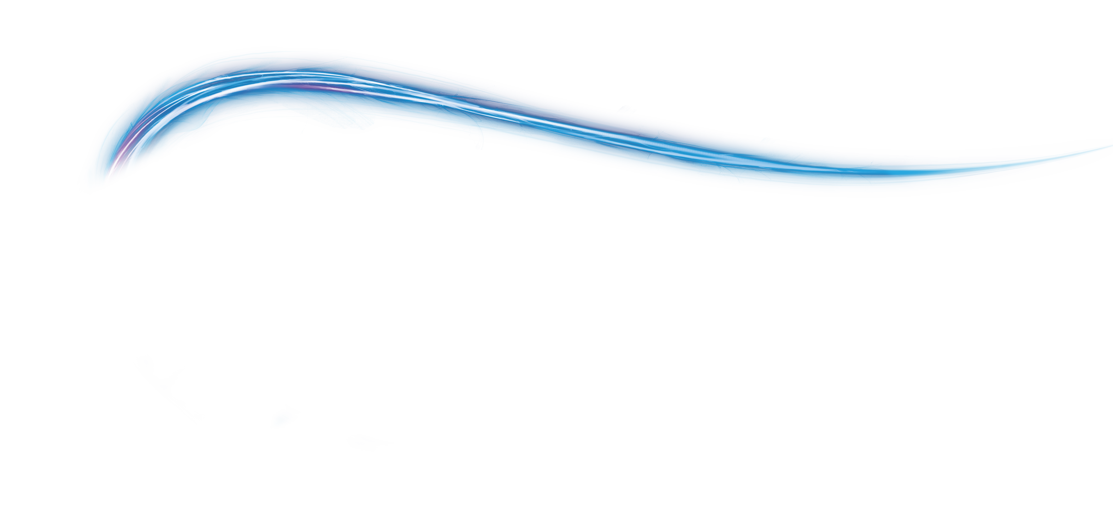




gyors letisztult biztonságos együttműködő
Notes:
Introducing IE9

Slide 5
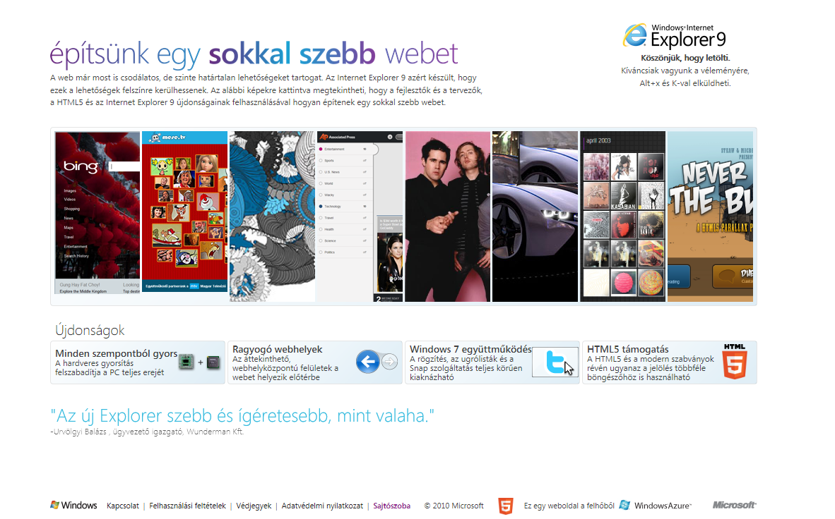

ismerje meg:
awebszepsege.hu
Töltse le az IE9-et
Tűzze le kedvenc oldalait
Csodálja a hardvergyorsított HTML5
tartalmakat
Notes:
And now you can go get IE9 at www.beautyoftheweb.com

